Slide 1







Applied Quantum Physics
Arno Rauschenbeutel, Philipp Schneeweiß, Sarah Skoff, Jürgen Volz
Angewandte Quantenphysik

Slide 2
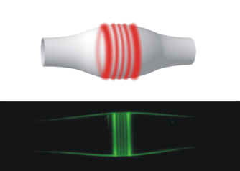
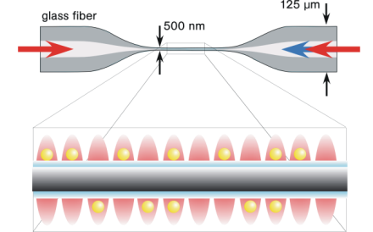

Coupling light and matter in the quantum regime with optical nanofibers
Research
fundamental research
quantum optics & nanophotonics
cavity quantum electrodynamics
quantum information & communication
hybrid quantum systems
applications and devices
all-optical switches
single photon sources & transistors
ultra-sensitive spectroscopy
technologies
lasers, optics, fiber optics
ultra-high vacuum and cryogenics
nanofiber fabrication & nano-processing
optical
microresonators
nanofiber-based
atom-traps
optical interfaces
for single molecules
Angewandte Quantenphysik

Slide 3
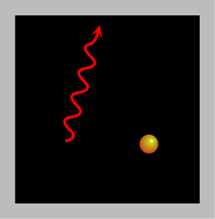
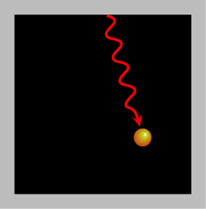
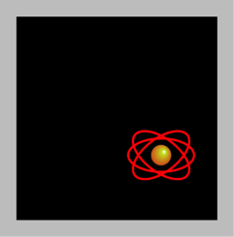
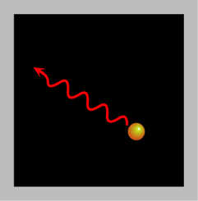
3 ECTS points
Vorlesung 141. A11: Quantenoptik II
Understanding the interaction of light and matter at the quantum mechanical level.
Electromagnetically induced transparency, slow light and quantum memories for light
Laser cooling and trapping of neutral atoms and ions
Photodetection: coherence, photon-photon correlations, correlation functions
Sources of non-classical light: entangled photon pairs, squeezed light, test of quantum mechanics
Selected topics from quantum information processing and communication
Date: Thursdays 10:00 – 12:00 Seminar-room DB gelb 03
contact: christoph.clausen@ati.ac.at schneeweiss@ati.ac.at
jvolz@ati.ac.at
Atom und Quantenphysik
Notes:
3

Slide 4
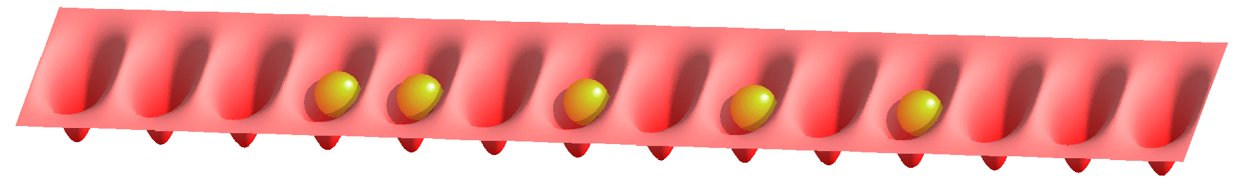
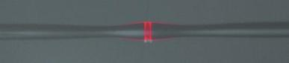
10 ECTS points, located at ATI
Projektarbeit: Quantum Optics 141.095
Understanding the basic concepts & experimental techniques in the field of quantum optics
laser, laser optics, laser stabilization, ultra-high vacuum technology, light detectors, preparation & characterization of atoms, molecules and other quantum emitters, cryogenics, laser cooling, …
Projektarbeit: Nanophotonics 141.A13
Understanding the basic concepts & experimental techniques in the field of nanophotonics
laser, laser optics, laser stabilization, light detectors, glass fibre optics, near-field effects, fabrication and characterization of photonic components, optical microresonators…
also suitable for bachelor projects
contact: Arno.Rauschenbeutel@ati.ac.at
Angewandte Quantenphysik
Notes:
4

